Slide 1


TEAM G
IN ACTION
EVOASTRA VENTURES
MINI PROJECT

Slide 2

AGENDA
In this mini project, our agenda is to scrape detailed car listings from cars24.com to build a comprehensive dataset. We will focus on gathering information such as car name, model, kilometers driven, fuel type, transmission type, discount price, actual price, location, and discount offered. Following the data collection, we will proceed with data cleaning and preprocessing, visualize key insights, and prepare a presentation to highlight our findings. The goal is to unlock valuable insights that will drive strategic decisions and enhance our understanding of the market.
1
ABOUT COMPANY
5
DATA WRANGLING
2
PROJECT
6
DATA VISUALIZATION
3
OUR TEAM
INSIGHTS
4
WEB SCRAPPING
CONCLUSION

Slide 3

EVOASTRA VENTURES
EVOASTRA VENTURES IS A COMPANY SPECIALIZING IN DATA SCIENCE AND AI SERVICES, OFFERING CUSTOMIZED SOLUTIONS, AI STRATEGY CONSULTING, AND MACHINE LEARNING MODEL DEVELOPMENT.
Founded by Aniket Manwatkar and Syeda Mariya Quadri in 2023.
Evoastra has completed over 356 projects and serves more than 16 brands and organizations.

Slide 4

PROJECT
•CARS24 is a leading AutoTech company streamlining and revolutionizing the sale, purchase, and financing of pre-owned cars in India, Australia, Thailand, and UAE founded in 2015.
• Leveraging a Smart AI Pricing Engine, and 140 quality checks, selling and buying pre-owned vehicles is seamless and transparent with CARS24.
OBJECTIVE
DETAILS TO SCRAPE
To scrape detailed car listings from Cars24.com to build a comprehensive dataset for analysis
Car Make
Model
Kilometers driven
Fuel type
Transmission type
Price
Location

Slide 5




OUR TEAM
TEAM LEAD
CO LEAD
MEMBERS
SUYASH CHADHA
ANKESH KUMAWAT
Sohan Kiran Patil
Uday Mahadev Sonar Pattar
Abhishek Kumar
Anant Anugrah Tudu
Sai eswar
Stella Maria Jose
Shivansh Jain
HomyaYaduma
Mariyambi nazar
Sanskrati Bordiya
Jai Vaishnav
Sanskar Kesari
Muhammed Kaif
SATWIK UPPADA
SANSKAR KESARI

Slide 6
WEB SCRAPPING
Objective : To scrape detailed car listings from cars24.com, capturing various attributes including car name, year of registration, kilometers driven, fuel type, transmission type, discount price, actual price, discount offered, model, and test drive location.
Tools and Technologies
Python
Selenium
BeautifulSoup
Edge WebDriver
Pandas
Jupyter notebook
Scrapped Details
Car brand (Maruti)
Model (Alto ....)
Registered year (2016)
Km driven (97,698KM)
Fuel type (petrol)
Transmission type (Manual)
Add-ons (low run cost)
Discount price (2.31 lakh)
Actual price (2.60 lakh)
Discount offered (28.76k off)
Test drive location (chhatarpur, Delhi)
SCRAPPED WEBSITE
Cars24.com

Slide 7
PROCESS OF SCRAPPING
INITIAL SCRAPPING ATTEMPT
SWITCH TO SELENIUM
Issue: Only 20 entries were retrieved as the site loads additional content dynamically using JavaScript.
Diagnosis: Disabling JavaScript revealed that only a limited set of data is visible without JavaScript, confirming dynamic content loading.
Reason: To handle dynamic content loading and JavaScript-driven updates.
Approach: Implemented scrolling and refreshing to load all entries.

Slide 8

CHALLEGES AND SOLUTIONS
Dynamic Content Loading
Challenge: The website uses JavaScript to dynamically load additional data.
Solution: Used Selenium to automate scrolling and reloading of the page to ensure all content is loaded and accessible.
Handling Multiple Data Points
Challenge: Different pieces of information were located in various parts of the HTML
Solution: Implemented a series of data extraction steps, each focusing on different attributes of the car listings.
Synchronization Issues
Challenge: Ensuring that data extraction steps are synchronized with page loading and content visibility.
Solution: Added delays and multiple page refreshes to make sure all content was loaded before extracting data.

Slide 9
DATA CLEANING
Objective : The goal of this project was to clean a dataset containing information about car sales. The dataset included columns such as "Km Driven," "Offer Price," "Original Price," "Discount Offered," and "Add ONs." The cleaning process involved handling missing values, converting data types, and standardizing the formats of various fields.
Technologies and Tools
Used
Python
Pandas
Numpy
Steps Involved in Data Cleaning
Loading the Data
Cleaning Functions
Applying Cleaning Functions
Handling Missing Values
Saving the Cleaned Data

Slide 10

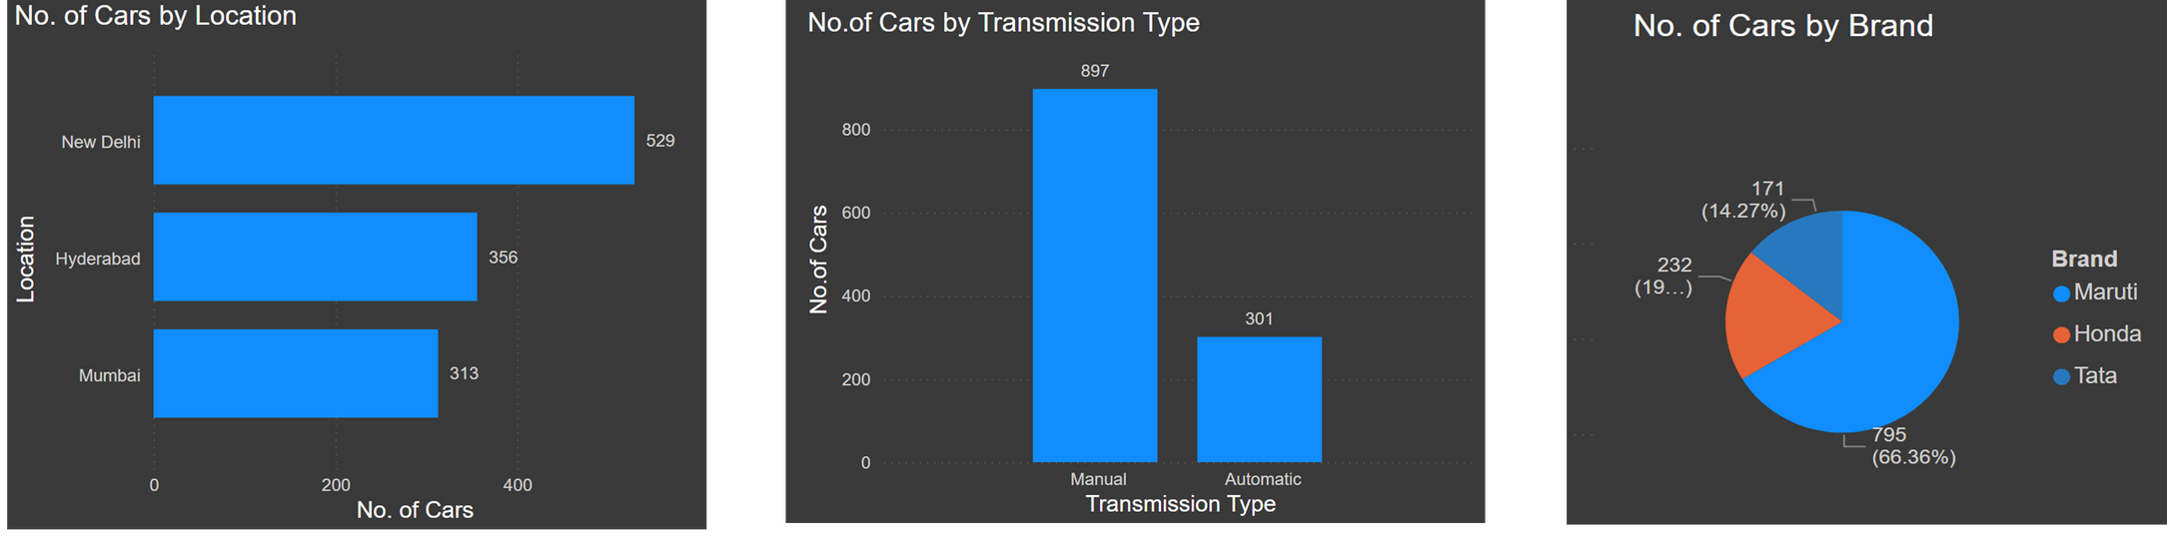
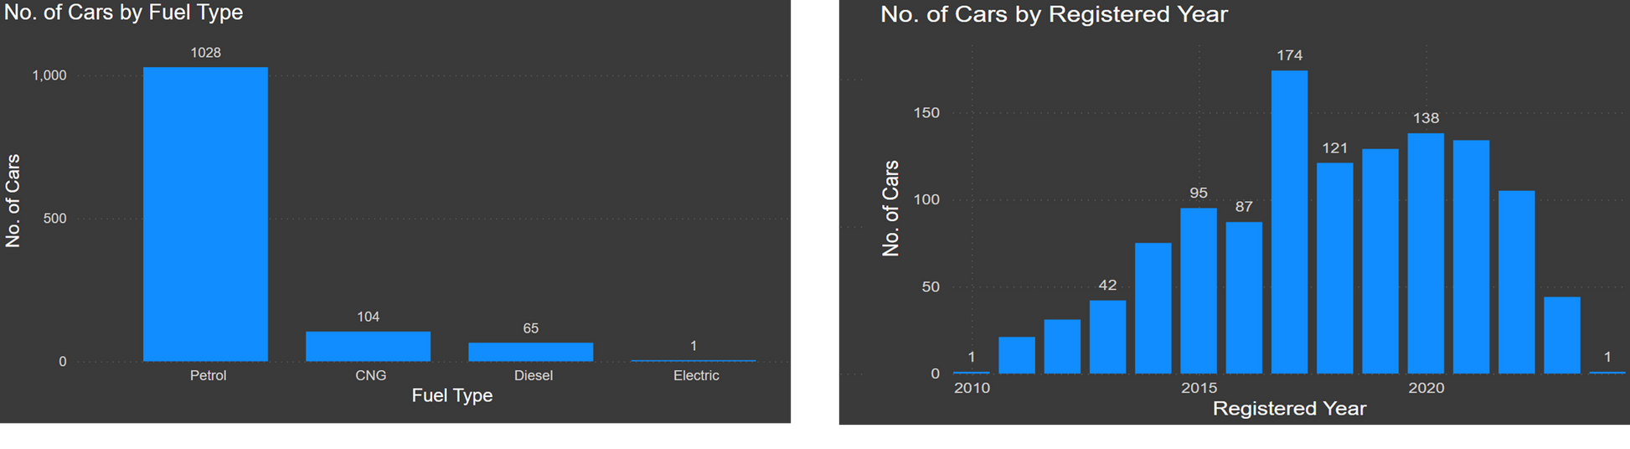
DATA VISUALIZATION

Slide 11
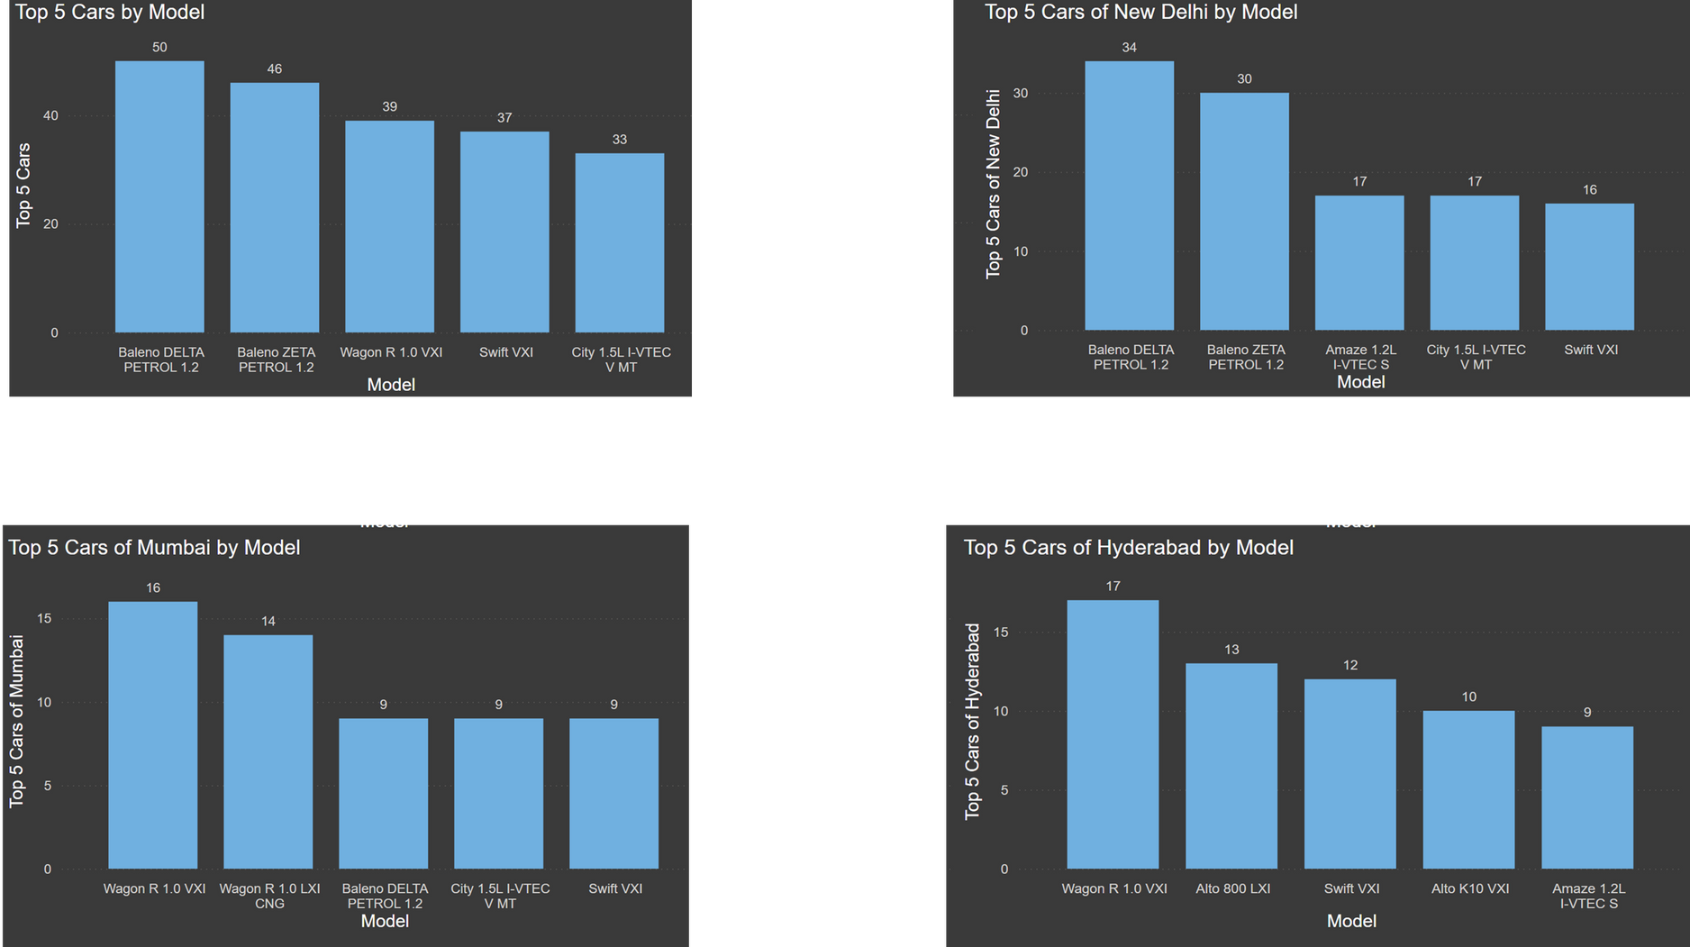

Slide 12
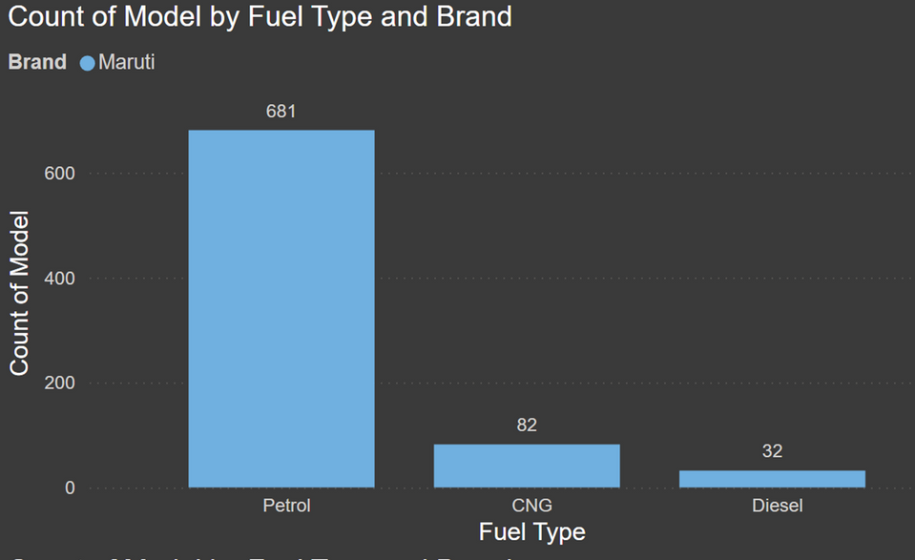
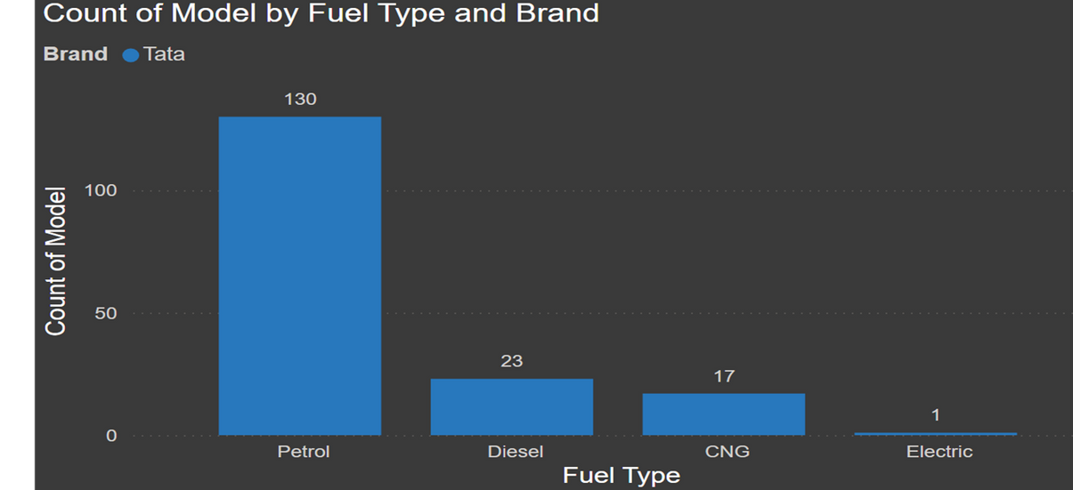
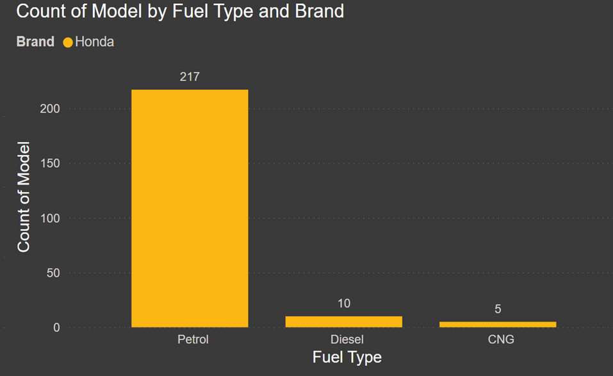
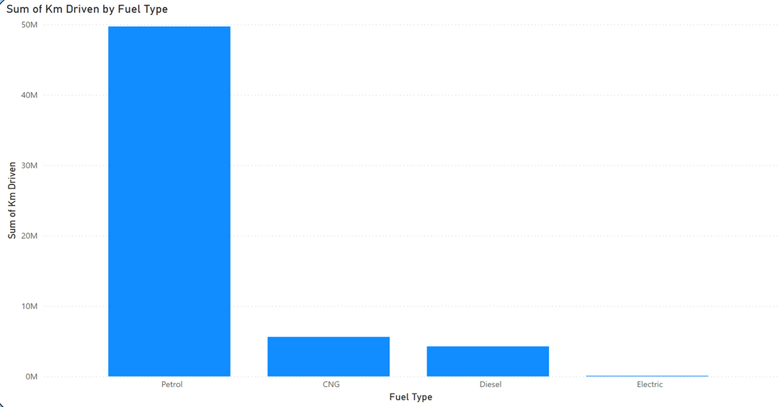

Slide 13
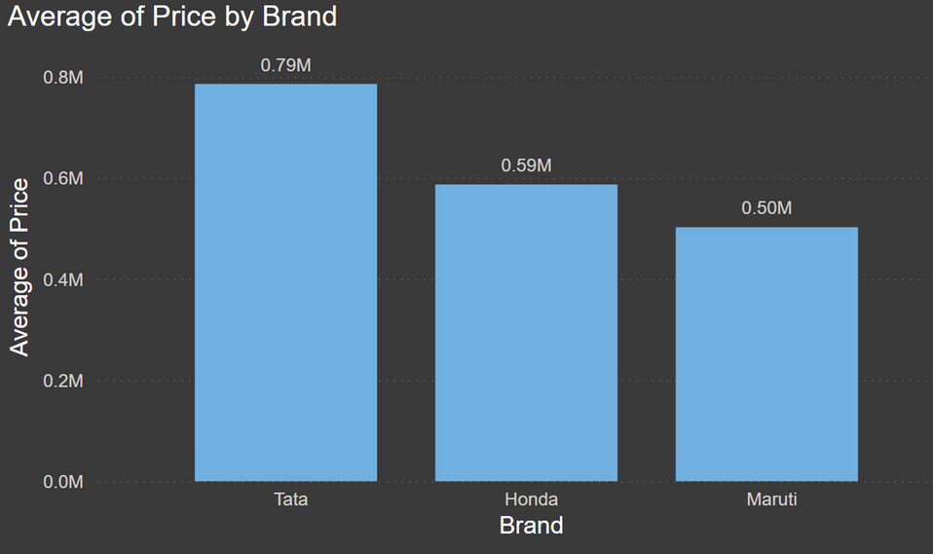
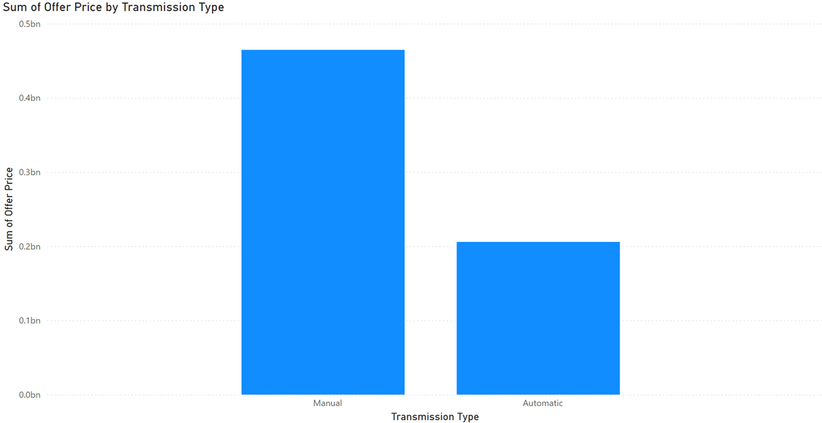
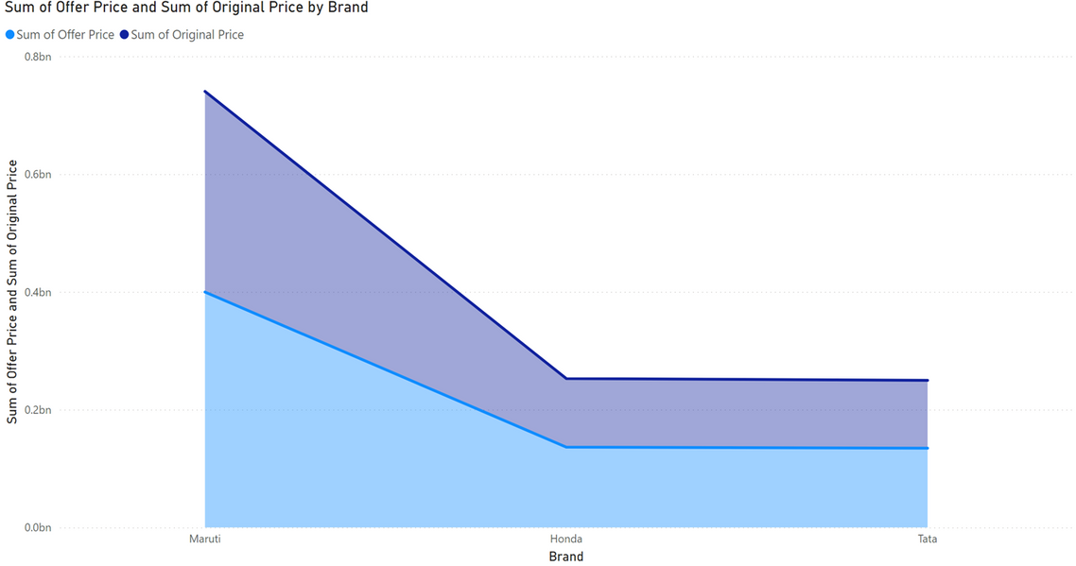
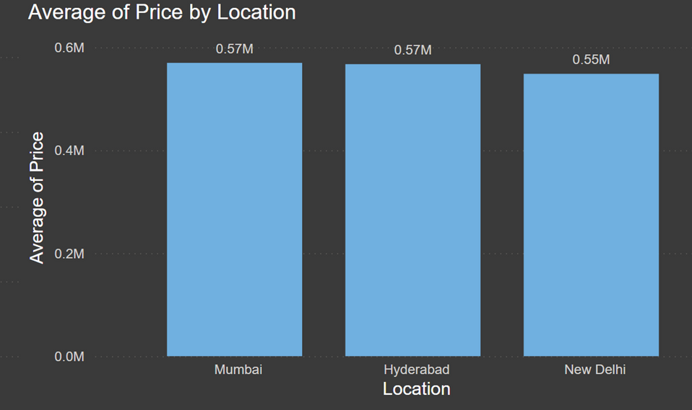

Slide 14
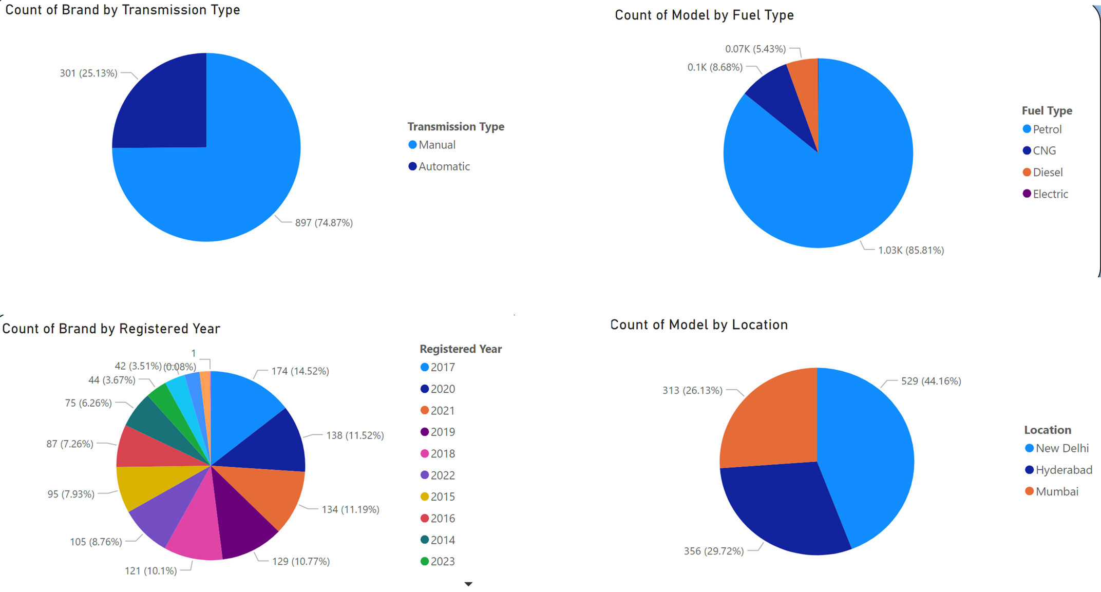

Slide 15
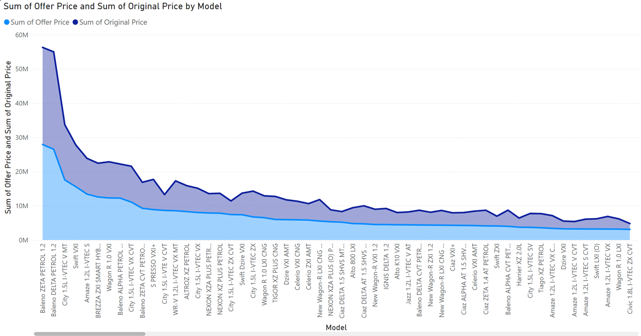

Slide 16
INSIGHTS
1. What is the average price of cars listed on Cars24.com?
Average Price: 502763.52
2. How does the average price vary by car brand?
MARUTI: 502763.522
HONDA: 587353.4483
TATA: 786345.0292
3. What is the distribution of cars by fuel type (e.g., petrol, diesel, electric)?
MARUTI: 795
CNG: 82
PETROL: 681
DIESEL: 32
HONDA: 232
CNG: 5
PETROL: 217
DIESEL: 10
TATA: 171
CNG: 17
PETROL: 130
DIESEL: 23
ELECTRIC: 01

Slide 17

CONCLUSION
In this mini project, we successfully scraped and analyzed detailed car listings from cars24.com to build a comprehensive dataset. By extracting key data points such as car name, model, kilometers driven, fuel type, transmission type, discount price, actual price, and location, we were able to gain valuable insights into market trends and pricing strategies. The data cleaning and preprocessing steps ensured the accuracy and reliability of our findings. Through effective data visualization with Power BI, we presented actionable insights that can drive strategic decisions and enhance market understanding. This project demonstrates the power of data-driven analysis in uncovering trends and informing business strategies in the automotive sector.

